Slide 1
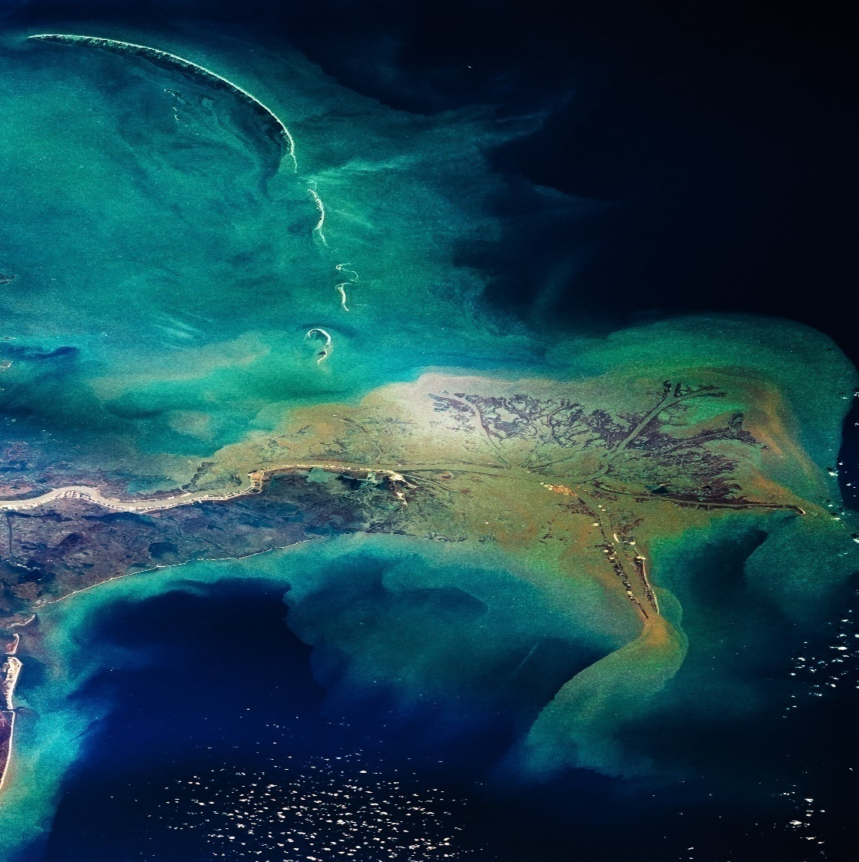

EARLY CAREER RESEARCH FELLOWSHIP – ENERGY TRACK
OFFICE HOURS
November 2022 update

Slide 2
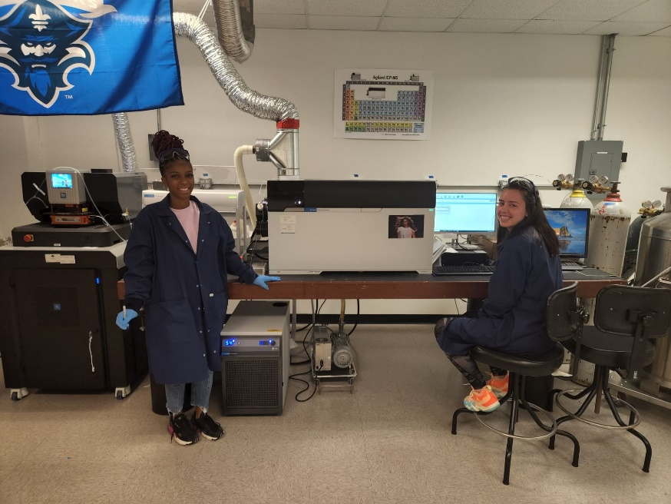
Overview of the Fellowship
Overview of the Program
What Fellows Receive
Eligibility
Application Resources
Key Dates
Q & A
Photo from Dr. Phoebe Zito
University of New Orleans | 2020 Fellow

Slide 3
HOUSEKEEPING
Submitting Questions
Please submit all questions via the Zoom chat at any time during the presentation.
We’ll address questions during the moderated Q&A portion at the end.
We’ll prioritize frequently asked questions and group similar ones together.
To keep us on time, verbal questions will not be taken.
Questions related to individual circumstances, follow-up or tailored guidance should be directed to gulffellowships@nas.edu
Time Considerations
We may not get to every question live.
Questions will be used to update our website.

Slide 4
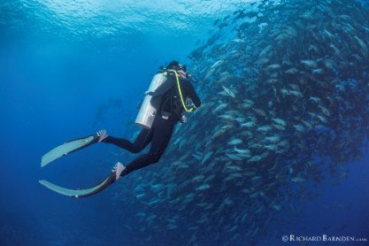
Early Career Research Fellowship (ECRF)
Supports emerging scientific leaders as they take risks on research ideas and build a network of colleagues who share their interest in improving offshore energy system safety and the well-being of coastal communities and ecosystems in the Gulf region.
Two-year fellowship
The Early-Career Research Fellowship is split into tracks that align with the Gulf Research Program’s priority areas. 2026 tracks are:
Community Track – CLOSED
Energy Track – OPEN
Environment Track – OPEN

Slide 5
ECRF Eligibility?
Hold a permanent, fully independent position as an investigator, faculty member, clinician scientist, or scientific team lead in industry, academia, or a research organization. A postdoc is not considered a fully independent position.
Be an early-career scientist who has received their eligible degree within the past 10 years (on or after January 1 of each year).
Hold a doctoral degree (e.g., PhD, ScD, EngD, MD, DrPH, EdD, DSW, etc.) in the social and behavioral sciences, health sciences and medicine, engineering and physical sciences, earth and life sciences, or interdisciplinary scientific fields relevant to the charge of the Gulf Research Program.
Be affiliated with a non-federal U.S. institution that has a valid tax ID number.
Not be currently employed by the U.S. federal government.

Slide 6
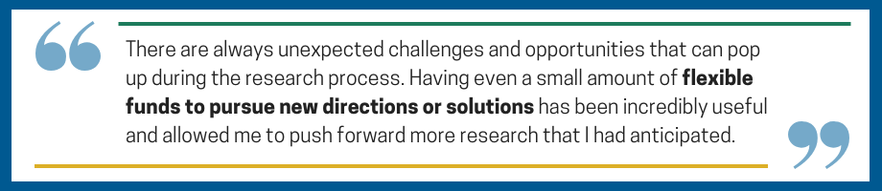
ECRF Fellows receive:
$75,000 is available for the fellow to use for research-related expenses, including equipment purchases, professional travel, professional development courses, trainee support, salary, or any other costs directly related to the fellow’s research.
The remaining $1,000 of the award serves as an honorarium for a mentor.

Slide 7
Current Cycle – Energy Track:
Track Goal: For the 2026-2028 Application Cycle, the Energy Track focuses on Legacy Energy Systems & Pathways Forward. This track invites interdisciplinary research that develops new knowledge, tools, or technologies for assessing and addressing the environmental, engineering, and/or community risks associated with legacy offshore energy infrastructure, including orphaned wells, aging platforms, and pipelines, and explore pathways for their safe decommissioning and/or repurposing.
Region: All proposed projects must focus on communities within the U.S. Gulf region, defined as Alabama, Florida, Louisiana, Mississippi, and Texas, consistent with the scope of the Gulf Research Program.
Application Deadline: May 5, 2026 by 5 pm ET
November 1, 2026: Fellowships begin

Slide 8
KEY DATES
May 5, 2026, 5:00 pm ET: Application deadline
May – July 2026: Review of written applications and selection of fellows
August 2026: All applicants notified of funding decisions
November 1, 2026: Fellowships begin. Required Virtual Orientation
October 31, 2028: End of Fellowship

Slide 9
MODERATED Q & A SESSION
Questions related to individual circumstances, follow-up or tailored guidance, email - gulffellowships@nas.edu

